Slide 1
Enhancing E-Commerce Decision-Making with an Online Retail Prediction Model
Ibrahim Mohammed Hamed
Github: https://github.com/ibrahimmohammedhamed/Capstone-Project.git

Slide 2
Brief overview
My project aims to leverage historical transaction data to forecast key business metrics such as sales trends, customer purchasing behavior, and demand fluctuations. By developing a machine learning-based prediction model, the goal is to provide e-commerce businesses with actionable insights to optimize inventory management, enhance marketing strategies, and improve overall decision-making. This project will demonstrate the power of data-driven decision-making in the competitive online retail space.

Slide 3
What questions I aim to answer
Research Questions
What are the most important factors influencing total revenue in online retail?
Can we accurately predict total revenue using transaction data such as quantity, unit price, and date?
Are there identifiable patterns in customer behavior or seasonal trends?
How do different models (e.g., Linear Regression vs. Random Forest) perform in forecasting revenue?

Slide 4
Data Sources
For this project, I am using the Online Retail Dataset, which contains historical transaction data from an e-commerce business. The dataset includes over 500,000 rows of transactions recorded between December 2010 and December 2011. The data was sourced from a publicly available repository, and no web scraping was required.
SOURCE: KAGGLE
Dataset Features
The dataset consists of eight key columns:
InvoiceNo – Unique identifier for each transaction
StockCode – Product identifier
Description – Product name
Quantity – Number of units purchased
InvoiceDate – Date and time of the transaction
UnitPrice – Price per unit of the product
CustomerID – Unique identifier for each customer
Country – Country where the transaction took place

Slide 5
Data Processing and Cleaning
Before analysis, I will clean and preprocess the data to handle missing values, duplicates, and inconsistencies:
Handling Missing Values: Some transactions have missing CustomerID values, which will be removed or imputed if necessary.
Removing Duplicates: Any duplicate records will be dropped to ensure data integrity.
Data Type Conversion: The InvoiceDate column will be converted to datetime format for time-series analysis.
Feature Engineering: A TotalRevenue column will be created by multiplying Quantity and UnitPrice to assess sales performance.
Data Sufficiency
The dataset is large enough to train a machine learning model effectively. Since it covers one year of transactions, it provides a strong basis for analyzing seasonal trends, customer behavior, and demand fluctuations. If needed, data augmentation techniques or external datasets (e.g., economic indicators) may be considered for further enhancements.

Slide 6
Exploratory Data Analysis (EDA)
1. Data Issues & Cleaning
Missing Values: The CustomerID column has missing values, which could affect customer behavior analysis. These rows will either be removed or imputed.
Duplicates: Some duplicate transactions were detected and will be removed.
Negative & Zero Quantities: Some transactions have negative or zero quantities, which might indicate refunds or data errors. These need further investigation.
2. Initial Patterns & Relationships
Sales Trends:
The dataset shows seasonal spikes, particularly in November and December, likely due to holiday shopping.
Weekdays generally have higher sales compared to weekends.
Customer Purchasing Behavior:
A small percentage of customers account for a large portion of revenue, suggesting a power-law distribution (Pareto principle).
Some customers make frequent small purchases, while others place large bulk orders.
Top Selling Products:
Certain products appear frequently in transactions, which may indicate bestsellers.
Some products have very low sales, possibly indicating excess inventory.

Slide 7
Key patterns or insights found during initial exploration

Slide 8
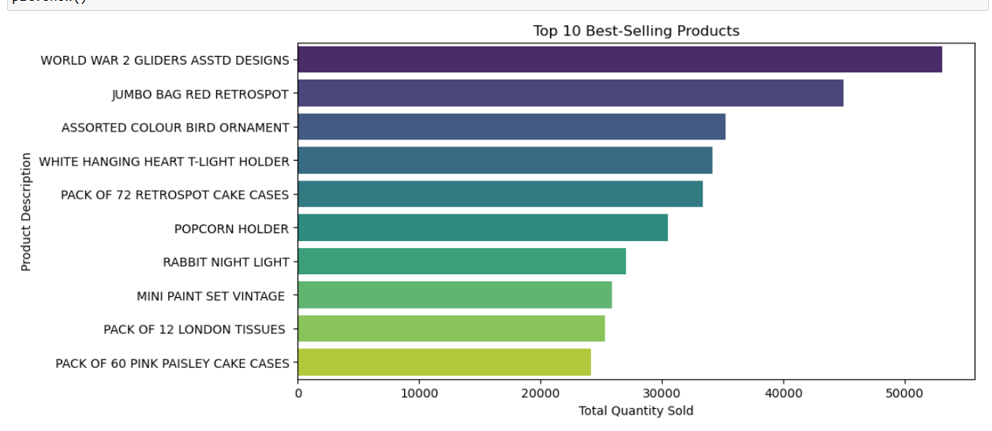
Top-Selling Products Identified: Certain products consistently ranked at the top in terms of quantity sold and revenue generated.

Slide 9
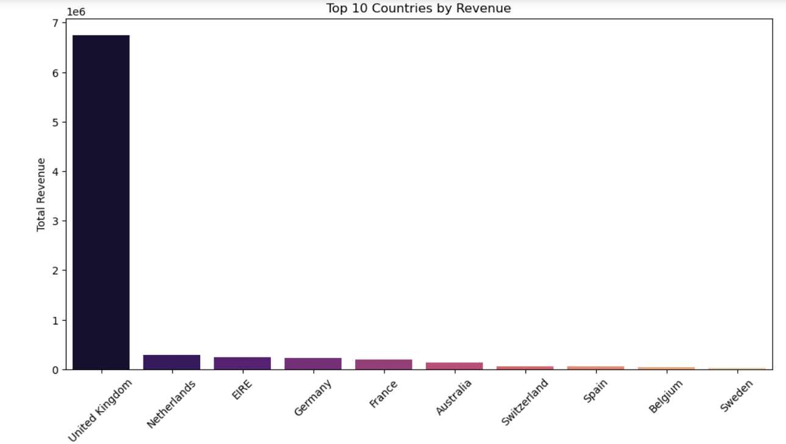
Customer Spending Patterns: Some customers made significantly higher-value purchases compared to the average.

Slide 10
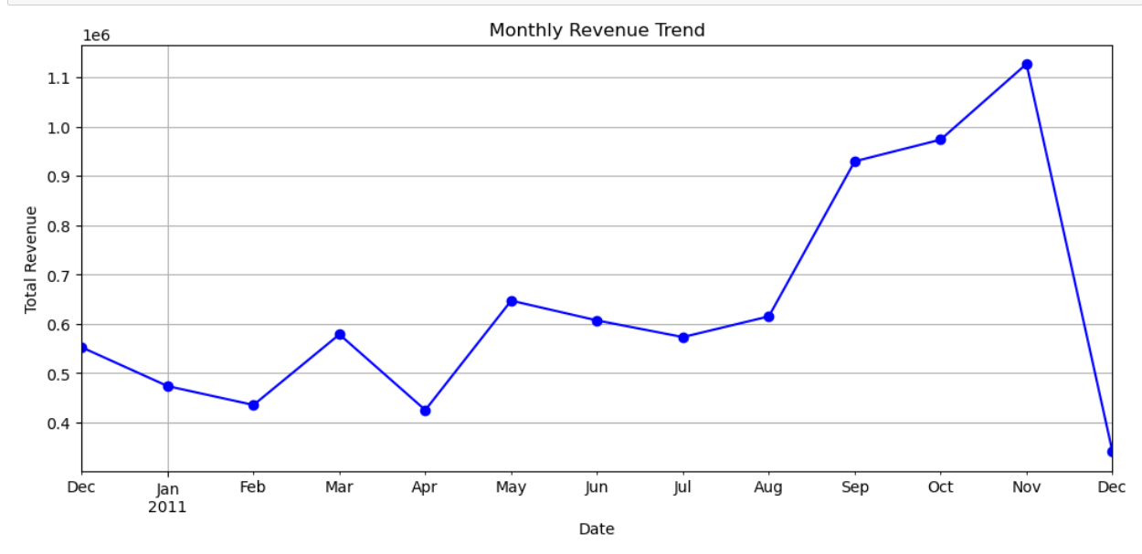
Seasonal/Monthly Trends: Sales peaked during certain months, suggesting strong seasonal patterns (e.g., holidays).

Slide 11
3. Outliers & Anomalies
Unusually Large Orders:
Some transactions involve extremely high quantities, possibly due to wholesale buyers or data entry errors. These will be checked and filtered if necessary.
High-Value Transactions:
Certain invoices show very high total revenue, likely due to bulk orders from businesses.
4. Feature Engineering Plans
To enhance model performance, the following new features will be created:
TotalRevenue = Quantity × UnitPrice (to measure order value)
Customer Purchase Frequency (to identify repeat customers)
Recency, Frequency, and Monetary (RFM) Analysis features for customer segmentation
Time-Based Features like Month, Day of Week, and Hour of Purchase for trend analysis
Code Status
Data Cleaning & Preprocessing: ✅ In progress
Basic Visualizations & Summary Stats: ✅ Partially completed
Feature Engineering: 🔄 Planned for next steps

Slide 12
Algorithms & Evaluation Metrics
Algorithms Used:
Linear Regression A simple, interpretable model used as a baseline for predicting revenue.
Random Forest Regressor A powerful ensemble model chosen for its ability to handle nonlinear relationships and variable importance.
Why These Models?
Linear Regression helps establish a clear, interpretable baseline.
Random Forest handles outliers and complex feature interactions well, making it suitable for retail data with high variability.
Evaluation Metrics
Mean Absolute Error (MAE): Measures average error in predictions.
Root Mean Squared Error (RMSE): Penalizes larger errors more heavily, useful for assessing overall model performance.
Model Performance
Linear Regression: MAE = 18.08, RMSE = 432.53
Random Forest: MAE = 3.70, RMSE = 631.76

Slide 13
✅ How I Planned this
Feature Importance Analysis
Used Random Forest model to understand what influences revenue most Key drivers included: Quantity, UnitPrice, and customer purchasing behavior
Deliverables Prepared Completed PowerPoint, poster, and cleaned notebook/code
Final paper included structured insights, visualizations, and results
Model Refinement Linear Regression and Random Forest models compared Random Forest had lower MAE (3.70) indicating better prediction accuracy Due to time limits, advanced models like XGBoost were not explored

Slide 14
Key Findings & Model Performance
Interpretation of Results
The Random Forest model achieved a low MAE (3.70), showing strong accuracy in predicting customer-level revenue.
However, its higher RMSE (631.76) indicates occasional large errors, possibly due to outliers or irregular purchasing behavior.
The Linear Regression model, while more interpretable, had a higher MAE (18.08) but a lower RMSE (432.53)—indicating more consistent but less accurate predictions on average.
Key Insights from Modeling
Customer behavior and product quantity had the strongest influence on revenue prediction.
Seasonal trends and frequent buyers were crucial for feature importance.
Data quality (e.g., missing CustomerIDs, negative quantities) impacted model precision.

Slide 15
Did We Meet the Objectives?
Yes — the project aligned well with the original goal:
Goal: The models provided actionable insights into customer spending and product demand patterns, helping e-commerce businesses:
Forecast revenue trends
Identify top-spending customers
Optimize inventory decisions
Objectives Met:
Cleaned and explored the data
Created new revenue features
Trained and evaluated models
Delivered actionable insights for retail forecasting

Slide 16
How the Results Address the Original Problem
The original problem highlighted the difficulty e-commerce businesses face in extracting actionable insights from large volumes of transaction data. This project aimed to solve that by developing a predictive model that could forecast customer revenue and purchasing behavior.
The results from the modeling phase directly address this challenge:
✅ Improved Decision-Making: The models help predict customer spending, enabling better planning for inventory, staffing, and marketing.
✅ Revenue Forecasting: Businesses can now anticipate high-value customers and peak buying periods, which supports budget and resource allocation.
✅ Customer Insights: By understanding what drives customer purchases, companies can personalize marketing strategies to boost engagement and retention.
✅ Operational Efficiency: Insights from data reduce guesswork in inventory and logistics, leading to cost savings and improved service.
In summary, the model transforms raw transaction data into practical insights, providing a reliable tool for strategic and operational enhancements—precisely what the original problem called for.

Slide 17
Project Conclusion
The project successfully demonstrated how machine learning can be applied to online retail data to generate predictive insights.
The Random Forest model proved to be more effective than Linear Regression in predicting revenue, with a significantly lower MAE.
By understanding key factors that drive revenue, this model can help businesses make better inventory, marketing, and sales decisions.
While there’s potential to improve the model further, the current results already show practical value and validate the project’s approach.
With more time or data, I would:
Explore deeper customer segmentation and seasonal trends
Test advanced models like XGBoost or LSTM for better accuracy
Incorporate external data (e.g., holidays, promotions) to improve predictions

